Slide 1


Ganancial, Jheric, L.
May 14, 2025

Slide 2
Outline
Executive Summary/Introduction
Methodology
Results
Conclusion
Appendix

Slide 3
Executive Summary/Introduction
Data Collection Methodology:
- Based on Lab 1 API Collecting the Data.ipynb and Lab 1.2 Web Scraping.ipynb, data was collected using two methods:
- SpaceX REST API: Collected historical launch data directly from the SpaceX API.
- Web Scraping: Scraped additional data, likely related to launch outcomes and details, from a Wikipedia page (List of Falcon 9 and Falcon Heavy launches).
Data Wrangling:
- Based on Lab 2 Data Wrangling.ipynb, the collected data was processed to clean, transform, and prepare it for analysis and model building. Key steps likely included handling missing values, converting data types, and potentially feature engineering.

Slide 4
Executive Summary/Introduction cont'd
Exploratory Data Analysis (EDA) using Visualization & SQL:
- Based on EDA with Visualization_Exploring and Preparing Data.ipynb, EDA was performed using visualizations to identify patterns and relationships in the data.
- Based on EDA with SQL_SQL Notebook for Peer Assignment.ipynb, EDA was also conducted using SQL queries on the dataset loaded into a database to extract insights and answer specific questions.
Interactive Visual Analytics using Folium and Plotly Dash:
- Based on Interactive Visual Analytics with Folium.ipynb, interactive maps were created using Folium to visualize launch sites and their proximity to geographical features.
- Based on spacex_dash_app.py and the provided screenshot, a dashboard was built using Plotly Dash to allow interactive exploration of launch data, likely focusing on launch success based on site and payload mass.

Slide 5
Executive Summary/Introduction cont'd
Predictive Analysis using classification models:
- Based on Machine Learning Prediction lab.ipynb, various classification models were built, tuned, and evaluated to predict the success of a Falcon 9 first stage landing. The process involved splitting data, training models (likely including Logistic Regression, SVM, Decision Tree, K-Nearest Neighbors), hyperparameter tuning (e.g., using GridSearchCV), evaluating performance (accuracy, confusion matrix), and selecting the best model.

Slide 6

Section 1

Slide 7
Methodology
Executive Summary
Data collection methodology
Perform data wrangling
Perform exploratory data analysis (EDA) using visualization and SQL
Perform interactive visual analytics using Folium and Plotly Dash
Perform predictive analysis using classification models

Slide 8
Data Collection – SpaceX API
Description: Data was collected by making GET requests to the SpaceX REST API. This involved querying specific endpoints to retrieve historical launch data, including details about missions, payloads, cores, and launch pads.
Key Phrases/Steps: REST API calls, GET requests, JSON response, data extraction, endpoints (e.g., /launches, /cores, /payloads, /launchpads).

Slide 9
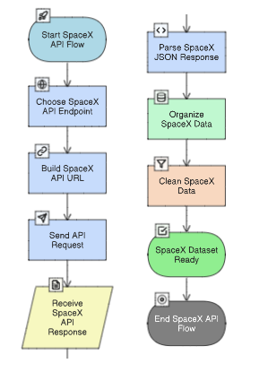
Data Collection – SpaceX API
Data Collection Flowchart:
GitHub URL: (https://github.com/jheric212/CS-Repo/blob/main/Lab%201%20APICollecting%20the%20Data%20.ipynb).

Slide 10
Data Collection - Scraping
Description: Additional launch data was obtained by scraping a Wikipedia page listing Falcon 9 and Falcon Heavy launches. Libraries like BeautifulSoup or pandas.read_html were likely used to parse the HTML content and extract data tables.
Key Phrases/Steps: Web scraping, Wikipedia, HTML parsing, BeautifulSoup, pandas.read_html, data table extraction.

Slide 11
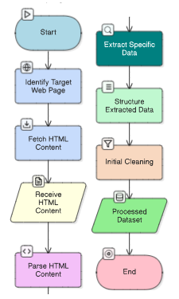
Data Collection – Scraping cont'd
Web Scraping Flowchart:
GitHub URL: (https://github.com/jheric212/CS-Repo/blob/main/Lab%201.2%20Web%20Scraping.ipynb).

Slide 12
Data Wrangling
Description: The collected data from both API and scraping sources was cleaned, transformed, and prepared for analysis. This involved handling inconsistencies, missing values, and converting data types to ensure data quality and suitability for subsequent steps.
Key Phrases/Steps: Data Cleaning, Handling Missing Values (e.g., imputing or dropping), Data Transformation, Feature Engineering (if any specific new features were created), Data Type Conversion, Merging/Combining Data (if data from different sources was combined).

Slide 13
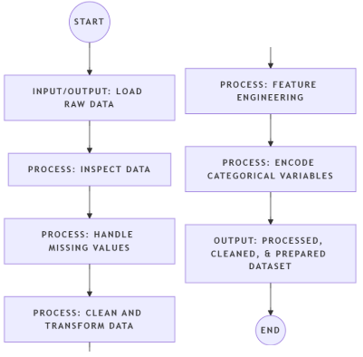
Data Wrangling cont'd
Data Wrangling Flowchart:
GitHub URL: (https://github.com/jheric212/CS-Repo/blob/main/Lab%202%20Data%20Wrangling.ipynb).

Slide 14
EDA with Data Visualization
Based on EDA with Visualization_Exploring and Preparing Data.ipynb, the notebook likely contains visualizations exploring relationships such as:
- Success rate vs. Launch Site (e.g., using bar plots or pie charts to see which sites have better success rates).
- Success rate vs. Payload Mass (e.g., scatter plots to see if payload mass influences success).
- Success rate vs. Orbit (e.g., box plots or bar plots to compare success across different orbits).
- Success rate vs. Booster Version (e.g., to see if newer booster versions improved success).
- Relationship between numerical features and landing outcome.

Slide 15
EDA with Data Visualization cont'd
These charts were used to visually identify patterns, trends, and correlations between launch parameters (site, payload, orbit, booster version) and the landing outcome (success/failure), guiding further analysis and feature selection for the predictive model.
GitHub URL: (https://github.com/jheric212/CS-Repo/blob/main/EDA%20with%20Visualization_Exploring%20and%20Preparing%20Data.ipynb).

Slide 16
EDA with SQL
Based on EDA with SQL_SQL Notebook for Peer Assignment.ipynb, the notebook likely contains SQL queries to:
View/Explore the dataset.
Count launches per launch site.
Calculate the average payload mass for launches.
Calculate the total number of successful landings.
Calculate the total number of successful landings per launch site.
Find the names of launch sites where successful landings occurred.
Calculate the number of launches per year.
Potentially other queries exploring specific conditions or aggregating data.
GitHub URL: (https://github.com/jheric212/CS-Repo/blob/main/EDA%20with%20SQL_SQL%20Notebook%20for%20Peer%20Assignment.ipynb).

Slide 17
Build an Interactive Map with Folium
Based on Interactive Visual Analytics with Folium.ipynb, the notebook likely created Folium maps to visualize launch sites and potentially successful/failed landing points. Objects added likely include:
- Markers: To indicate the location of each launch site.
- Circles: To represent launch sites or landing points, potentially color-coded by success/failure.
- Lines: To show distances or relationships between sites and other features (e.g., coastlines, highways, railways, cities) as explored in the lab instructions.
These objects make the geographical data interactive and visually explorable, allowing users to understand the spatial distribution of launch sites and their proximity to relevant infrastructure or geographical features, which might influence launch success.
GitHub URL: (https://github.com/jheric212/CS-Repo/blob/main/Interactive%20Visual%20Analytics%20with%20Folium.ipynb).

Slide 18
Build a Dashboard with Plotly Dash
Based on spacex_dash_app.py, the dashboard includes:
- A dropdown for selecting a Launch Site (including an 'All Sites' option).
- A range slider for selecting a Payload Mass range.
- A Pie Chart showing the success vs. failure count for the selected launch site (or all sites).
- A Scatter Chart showing the relationship between Payload Mass, Booster Version Category, and landing outcome (success/failure) for the selected launch site (or all sites), filtered by the payload range.
Why these plots and interactions: The interactive elements (dropdown, slider) allow users to dynamically filter the data and visualize launch success rates and payload mass relationships for specific sites or payload ranges. The pie chart provides a summary of success distribution, while the scatter plot helps identify trends related to payload and booster versions.

Slide 19
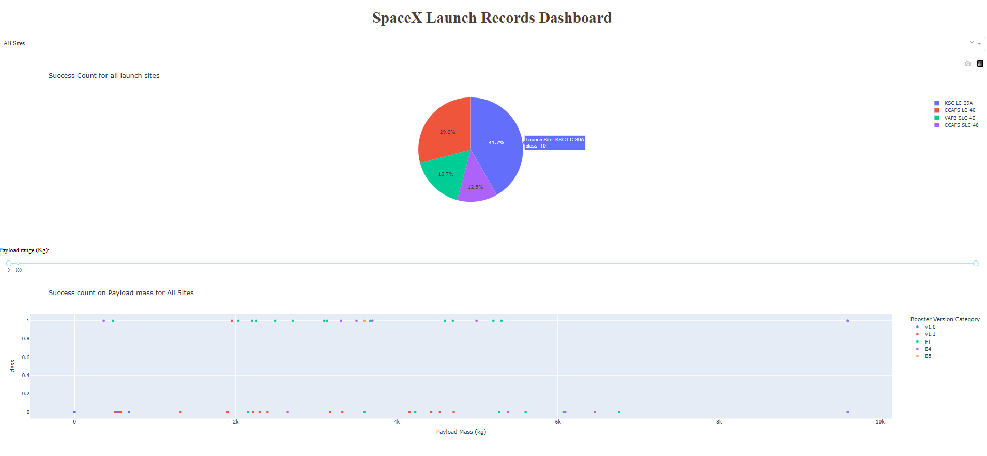
Build a Dashboard with Plotly Dash cont'd
GitHub URL: (https://github.com/jheric212/CS-Repo/blob/main/spacex_dash_app.py).
SpaceX Launch Records Dashboards Screenshot:

Slide 20
Predictive Analysis (Classification)
Summary of model development process: Based on Machine Learning Prediction lab.ipynb, the process involved:
- Preparing the data (likely using the wrangled and one-hot encoded data from previous steps).
- Splitting the data into training and testing sets.
- Building and training multiple classification models (Logistic Regression, SVM, Decision Tree, K-Nearest Neighbors).
- Using GridSearchCV to perform hyperparameter tuning for each model to find the best parameters.
- Evaluating the performance of the tuned models on the test set, primarily using accuracy and confusion matrices.
- Comparing the performance of the different models to identify the best performing one.

Slide 21
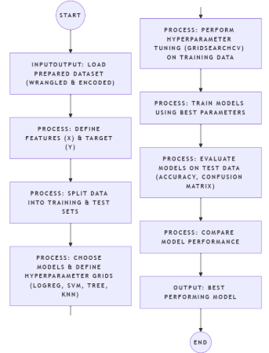
Predictive Analysis (Classification) cont'd
Key Phrases/Steps: Data splitting (train/test), Model Training (Logistic Regression, SVM, Decision Tree, KNN), Hyperparameter Tuning (GridSearchCV), Model Evaluation (Accuracy, Confusion Matrix), Model Comparison, Best Model Selection.
Machine Learning Prediction Flowchart:
GitHub URL: (https://github.com/jheric212/CS-Repo/blob/main/Machine%20Learning%20Prediction%20lab.ipynb).

Slide 22
Results
Summary of Results: This section consolidates key findings from EDA and the Machine Learning model.
Interesting Patterns Found During EDA
Success Rate Trend: Landing success probability generally increases with higher flight numbers.
Payload Mass Influence: Payload mass affects success, with successful landings achieved even for more massive payloads.
Launch Site Variation: Success rates and launch frequency vary across different launch sites.
Orbit Impact: Different orbits show varying success rates, indicating orbit type is a factor in landing outcome.

Slide 23

Results cont'd
Best Classification Model Accuracy
One of the best performing models (e.g., Logistic Regression, SVM based on accessible content) achieved a test accuracy of approximately 0.833.
This indicates the model correctly predicted the landing outcome for about 83.3% of the test cases.

Slide 24
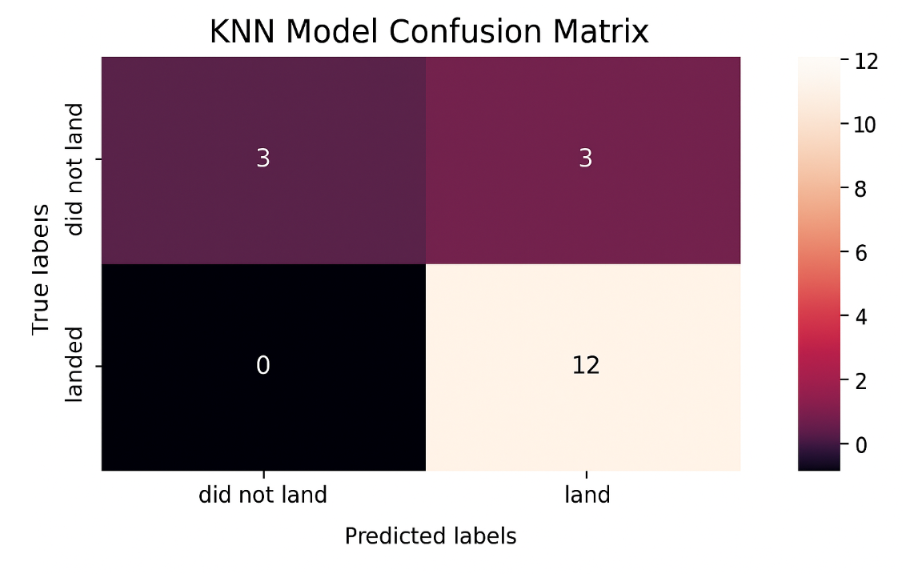
Results cont'd
Confusion Matrix of Best Model & Interpretation
True Positives (TP): 12 - The model correctly predicted a successful landing when it occurred.
True Negatives (TN): 3 - The model correctly predicted a failed landing when it occurred.
False Positives (FP): 3 - The model incorrectly predicted a successful landing when it actually failed.
False Negatives (FN): 0 - The model incorrectly predicted a failed landing when it actually succeeded.
Interpretation: The confusion matrix shows the model is good at identifying actual successful landings (zero false negatives in this test set example). However, it sometimes incorrectly predicts a landing when it doesn't occur (3 False Positives), which was noted as a key challenge in the analysis.

Slide 25
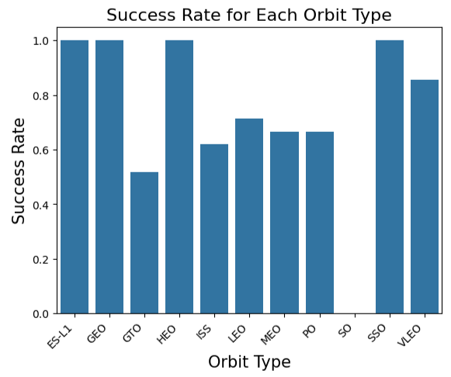
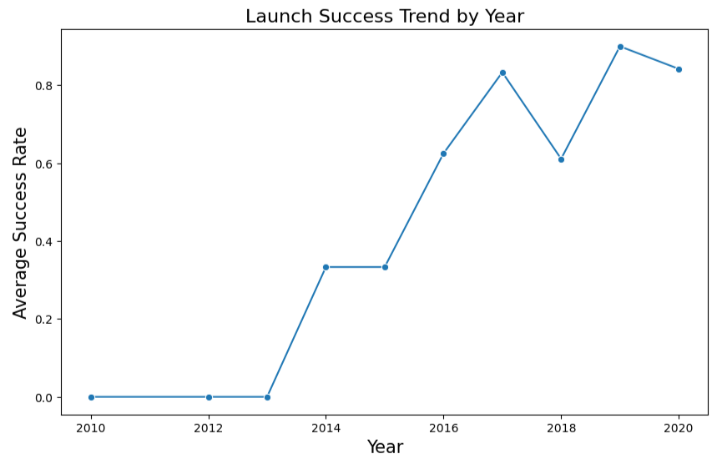
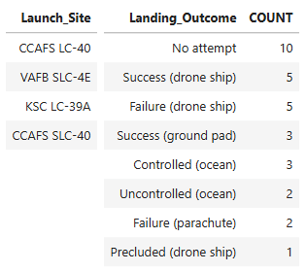
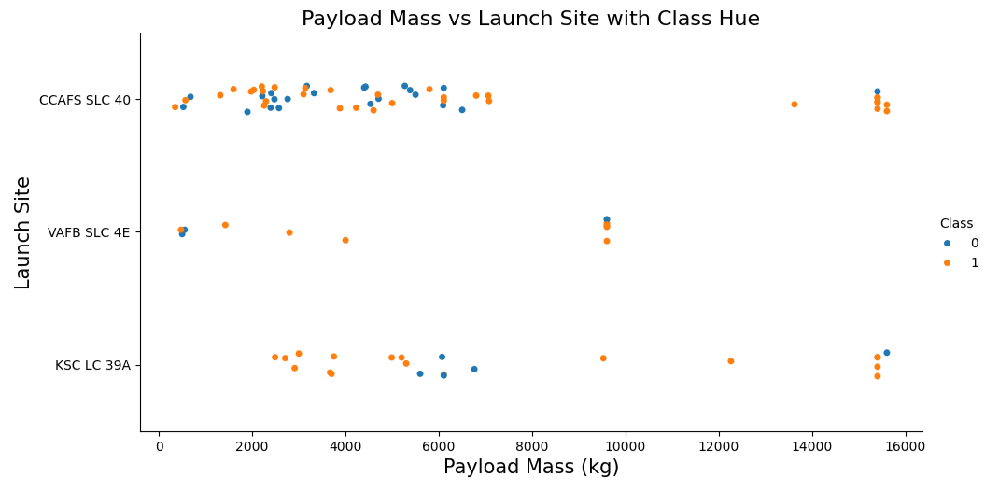
Results cont'd
Key EDA & SQL Findings:
- Visual Insights: Plots show important relationships, such as how launch success rates vary by Launch Site, change with Payload Mass and Flight Number, and differ across Orbits.
- SQL Summaries: Query results highlight key metrics and counts derived from the data, including total successful landings per site and average payload mass.

Slide 26
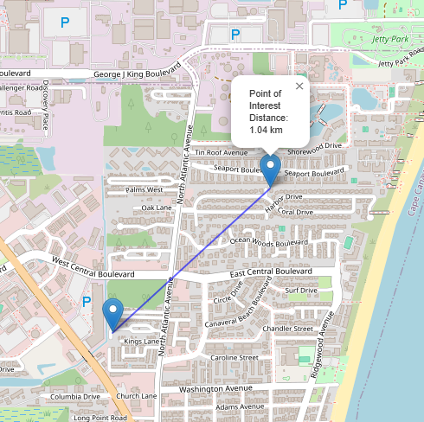
Results cont'd
Interactive Map with Folium:
- This interactive map visualizes the locations of the SpaceX launch sites.
- Map objects (such as markers, circles, and potentially lines) highlight the launch sites and their geographical context.
- Key Findings: Helps understand the spatial distribution of launch sites and their proximity to relevant features like coastlines, highways, railways, or cities, which could influence operations or safety.

Slide 27

Section 2

Slide 28
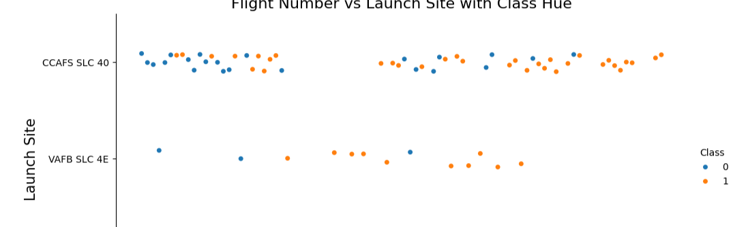
Flight Number vs. Launch Site
This scatter plot shows the relationship between the sequence of Flight Numbers, Launch Sites, and the Landing Outcome (Success/Failure).
Each point represents a launch, positioned by its flight number and launch site, and colored to indicate if the landing was successful.
Key Findings: This visualization helps to see:
How the distribution of launches over time (Flight Number) varies across different launch sites.
If there's a trend in landing success over time at each specific site.
Visual differences in success rates or activity between the launch sites across the recorded flights.

Slide 29
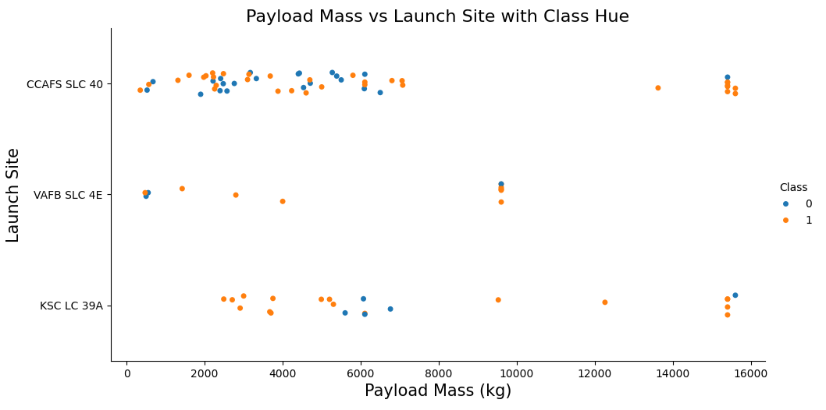
Payload vs. Launch Site
This scatter plot visualizes the relationship between Payload Mass, Launch Site, and the Landing Outcome (Success/Failure).
Each point represents a launch, positioned by its payload mass and launch site, and colored by landing success.
Key Findings: This helps to explore:
The range of payload masses launched from each site.
If certain payload mass ranges launched from specific sites tend to have higher success rates.
Visual differences in the distribution of payload masses and their outcomes across the various launch sites.

Slide 30
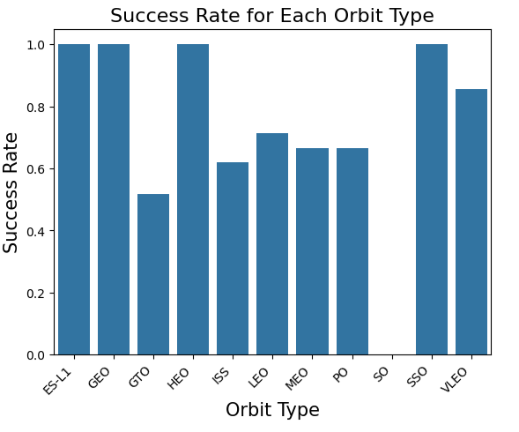
Success Rate vs. Orbit Type
This chart visualizes the success rate of Falcon 9 first stage landings for each different Orbit type.
Each bar (or segment/point, depending on the chart type) represents an orbit, showing the percentage or proportion of successful landings achieved in that specific orbit.
Key Findings: This helps to identify which orbit types are associated with higher or lower landing success rates, revealing if the target orbit significantly impacts the probability of a successful first stage return.

Slide 31
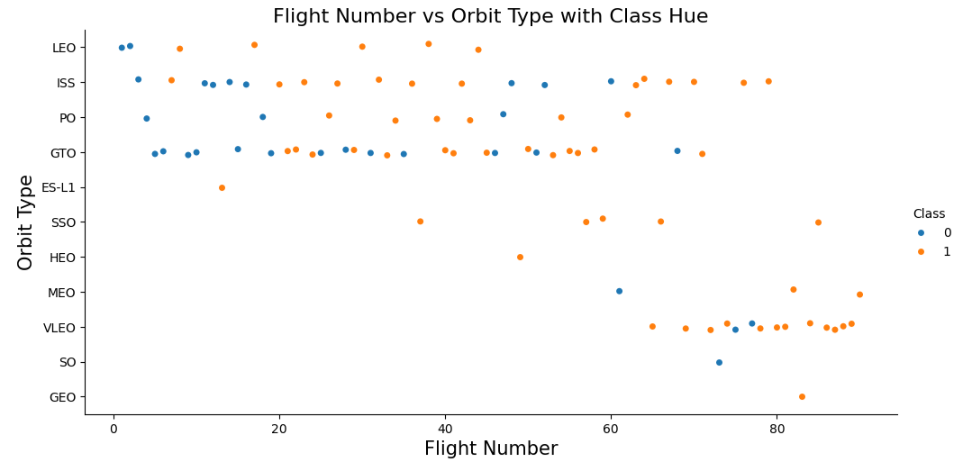
Flight Number vs. Orbit Type
This scatter plot visualizes the relationship between the sequence of Flight Numbers, Orbit Types, and the Landing Outcome (Success/Failure).
Each point represents a launch, positioned by its flight number and orbit type, and colored to indicate if the landing was successful.
Key Findings: This visualization helps to explore:
How the types of orbits targeted have changed over the history of Falcon 9 launches (Flight Number).
The distribution of successful and failed landings within each specific orbit type across different flights.

Slide 32
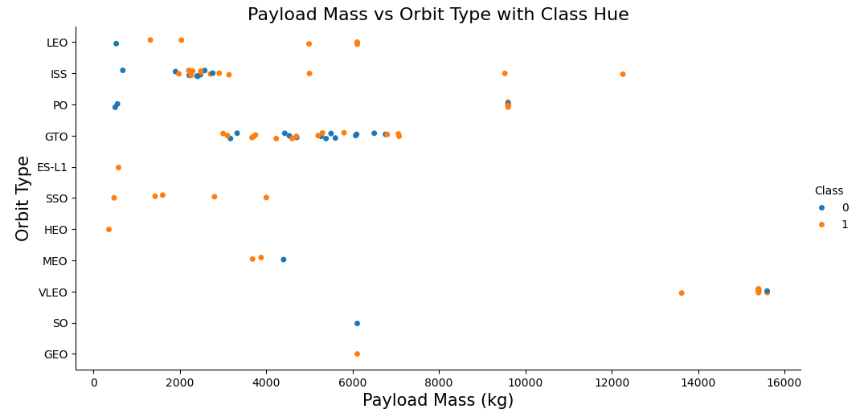
Payload vs. Orbit Type
This scatter plot visualizes the relationship between Payload Mass, Orbit Type, and the Landing Outcome (Success/Failure).
Each point represents a launch, positioned by its payload mass and orbit type, and colored by landing success.
Key Findings: This visualization helps to explore:
The typical payload mass ranges associated with different orbit types.
The distribution of successful and failed landings for specific combinations of payload mass and orbit.

Slide 33

Launch Success Yearly Trend
This line chart shows the average success rate of Falcon 9 first stage landings year by year.
Each point on the line represents the calculated average success rate for a specific year.
Key Findings: This visualization clearly illustrates the trend in landing success over time, showing how SpaceX's success rate has evolved annually throughout their launch history. You can observe if the success rate has generally increased over the years, indicating improvements in technology or procedures.

Slide 34
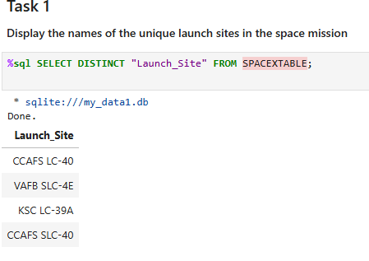
All Launch Site Names
Task: Find the names of the unique launch sites in the space mission dataset.
Query Result (Unique Launch Sites):
CCAFS LC-40
VAFB SLC-4E
KSC LC-39A
CCAFS SLC-40
Explanation: This query identifies all the distinct locations from which the SpaceX missions in this dataset were launched. The result shows the specific launch pads used.

Slide 35
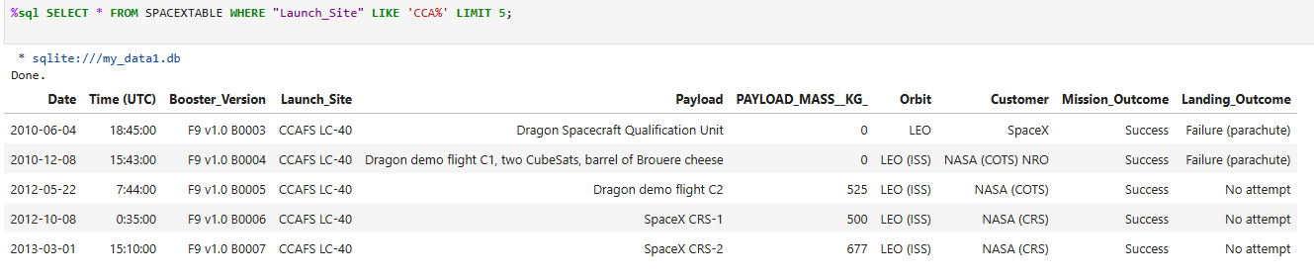
Launch Site Names Begin with 'CCA'
Task: Find 5 records where the launch site begins with the string 'CCA'.
Query Result: This query returns the first 5 rows from the dataset where the Launch_Site column starts with "CCA". The output is a table showing all columns (Date, Time, Booster_Version, Launch_Site, etc.) for these initial launches from the CCA sites.
Explanation: This result provides sample records for launches specifically from the Cape Canaveral (CCA) launch complexes, giving a glimpse into early missions from these sites.

Slide 36
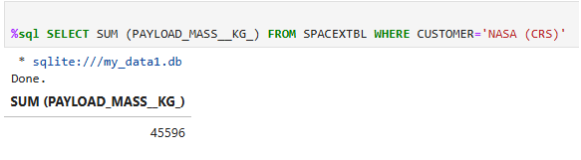
Total Payload Mass
Task: Calculate the total payload mass carried by boosters launched for the customer 'NASA (CRS)'.
Query Result (Total Payload Mass):
45596
Explanation: This query sums the PAYLOAD_MASS__KG_ for all rows where the CUSTOMER is 'NASA (CRS)'. The result shows the cumulative payload mass transported by SpaceX for NASA's Commercial Resupply Services missions in this dataset.

Slide 37
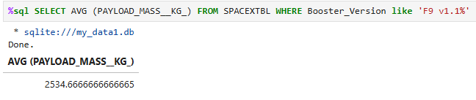
Average Payload Mass by F9 v1.1
Task: Calculate the average payload mass carried by boosters of version F9 v1.1.
Query Result (Average Payload Mass):
2534.6666666666665
Explanation: This query calculates the average payload mass for all launches using a booster version starting with 'F9 v1.1'. The result indicates the typical payload capacity for this specific version of the Falcon 9 booster.

Slide 38
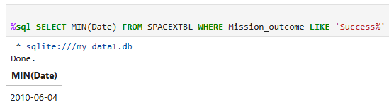
First Successful Ground Landing Date
Task (as titled in notebook): List the date when the first successful landing outcome in ground pad was achieved.
Query Result (from notebook):
2010-06-04
Explanation: The query provided for this task in the notebook finds the earliest date among missions with a 'Success' outcome. The result shows the date of the first overall successful mission recorded in the dataset. (Note: The query shown specifically filters on Mission_outcome being 'Success', not the Landing_Outcome on a 'ground pad' as stated in the task title).

Slide 39
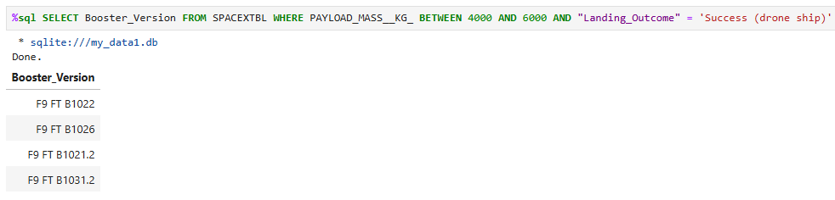
Successful Drone Ship Landing with Payload between 4000 and 6000
Task: List the names of the boosters which have successfully landed on a drone ship and had a payload mass greater than 4000 kg but less than 6000 kg.
Query Result (Booster Versions):
F9 FT B1022
F9 FT B1026
F9 FT B1021.2
F9 FT B1031.2
Explanation: This query filters the data to find specific booster versions that achieved a successful landing on a drone ship while carrying a payload mass between 4000 kg and 6000 kg. The result lists the boosters capable of this specific type of successful recovery under these conditions.

Slide 40
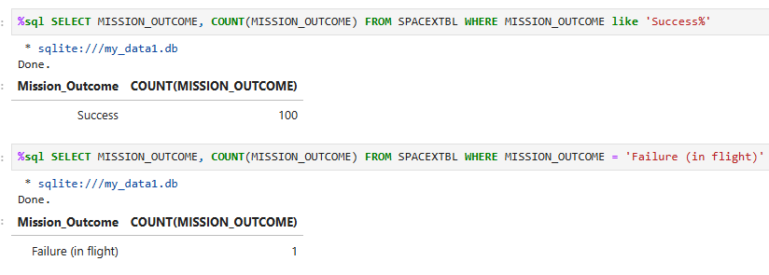
Total Number of Successful and Failure Mission Outcomes
Task: Calculate the total number of successful and failure mission outcomes.
Query Results:
Successful Missions Count: 100
Failure Missions Count: 1
Explanation: These queries count missions based on their overall outcome status. The results show the total number of missions recorded in the dataset that were classified as 'Success' and 'Failure (in flight)'.

Slide 41
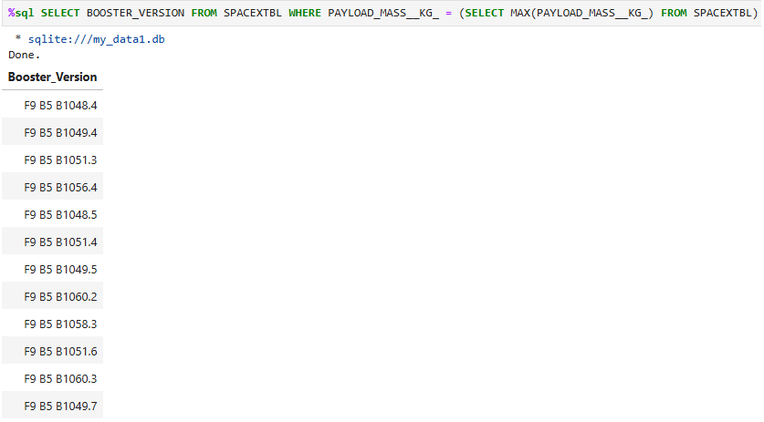
Boosters Carried Maximum Payload
Task: List the names of the booster versions that have carried the maximum payload mass.
Query Result (Booster Versions):
F9 B5 B1048.4
F9 B5 B1049.4
F9 B5 B1051.3
F9 B5 B1056.4
F9 B5 B1048.5
F9 B5 B1051.4
F9 B5 B1049.5
F9 B5 B1060.2
F9 B5 B1058.3
F9 B5 B1051.6
F9 B5 B1060.3
F9 B5 B1049.7
Explanation: This query identifies the specific booster versions that have successfully carried the heaviest payloads recorded in the dataset. The result lists the versions capable of handling the maximum payload mass.

Slide 42
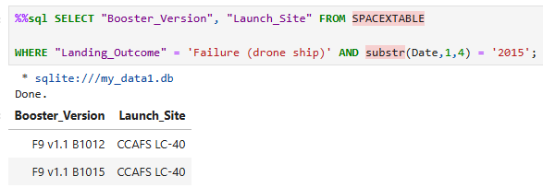
2015 Launch Records
Task: List the records displaying the month names, failure landing outcomes in drone ship, booster versions, and launch site for the months in year 2015.
Query Result (from notebook):
F9 v1.1 B1012 (CCAFS LC-40)
F9 v1.1 B1015 (CCAFS LC-40)
Explanation: This query filters the data for launches in the year 2015 that had a 'Failure (drone ship)' as the Landing_Outcome. The result lists the specific booster versions and the launch sites involved in these failed drone ship landing attempts during 2015. (Note: The query shown in the notebook does not select the month names, although the task title mentions them).

Slide 43
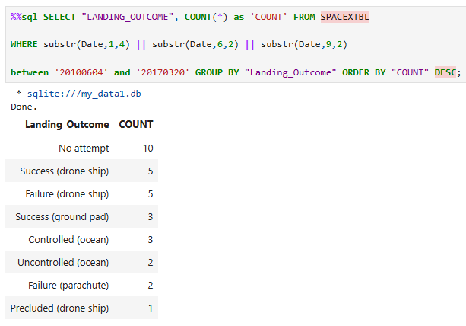
Rank Landing Outcomes Between 2010-06-04 and 2017-03-20
Task: Rank the count of landing outcomes (such as Failure (drone ship) or Success (ground pad)) between the date 2010-06-04 and 2017-03-20, in descending order.
Query Result (Ranked Counts):
No attempt: 10
Success (drone ship): 5
Failure (drone ship): 5
Success (ground pad): 3
Controlled (ocean): 3
Uncontrolled (ocean): 2
Failure (parachute): 2
Precluded (drone ship): 1
Explanation: This query counts the occurrences of each distinct landing outcome within the specified date range and orders them from most frequent to least frequent. The result shows the ranking of how often different landing scenarios occurred during that period.

Slide 44

Section 3

Slide 45
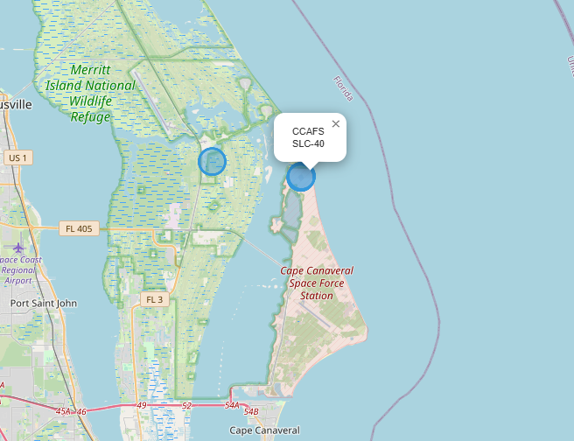

Interactive Map with Launch Sites
This map shows the global locations of the SpaceX launch sites used in this dataset (Cape Canaveral, Vandenberg, Kennedy Space Center).
Markers indicate the precise positions of these sites on the map.
Key Finding: This visualization provides a geographical context for the launch locations, showing their distribution along the coasts of the United States.

Slide 46
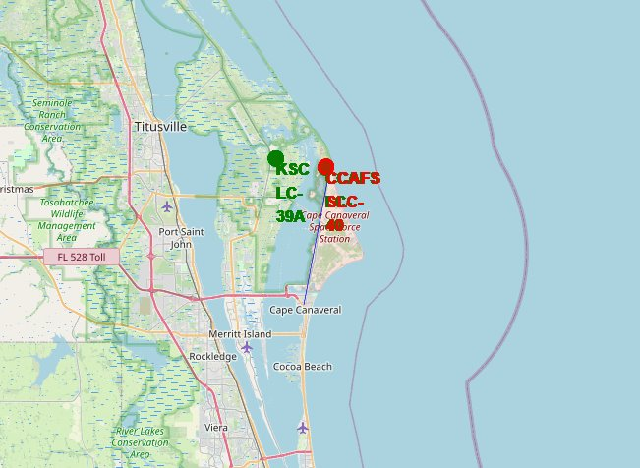
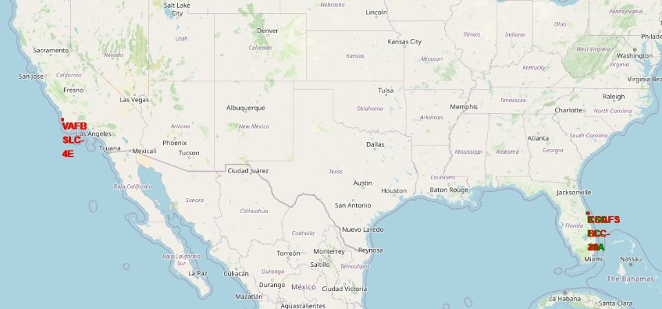
Launch Outcomes by Location (Folium Map)
This map visualizes the outcome of each individual launch, marked by colored circles or markers placed at the launch site coordinates.
Green indicates a successful landing outcome, while Red indicates a failed landing outcome.
Key Findings: This visualization allows for a detailed look at the distribution of successes and failures across the different launch sites. You can visually assess if certain sites have a higher concentration of successful or failed landing attempts, and see the mix of outcomes at each location.

Slide 47
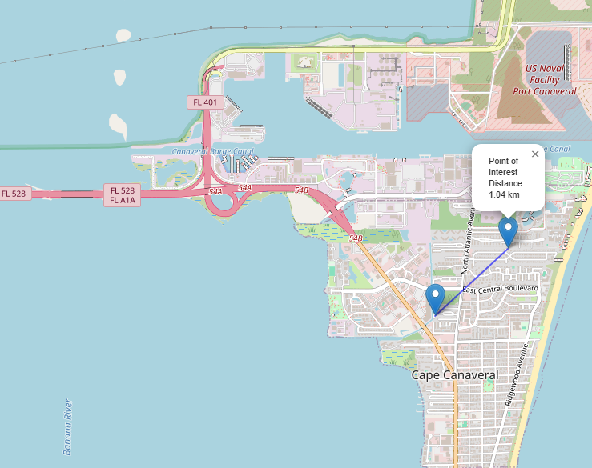
Launch Proximity Analysis (Folium Map)
This map visualizes the geographical proximity of a launch site to key nearby infrastructure and natural features.
Lines connect the launch site to specific points on the coastline, a highway, and a railway.
Distances, calculated and displayed on the map, quantify how close the launch site is to these features.
Key Findings: This analysis helps understand the logistical advantages (e.g., closeness to transport for rockets/payloads) and potential safety considerations (e.g., distance from populated areas) associated with the launch site's location.

Slide 48

Section 4

Slide 49
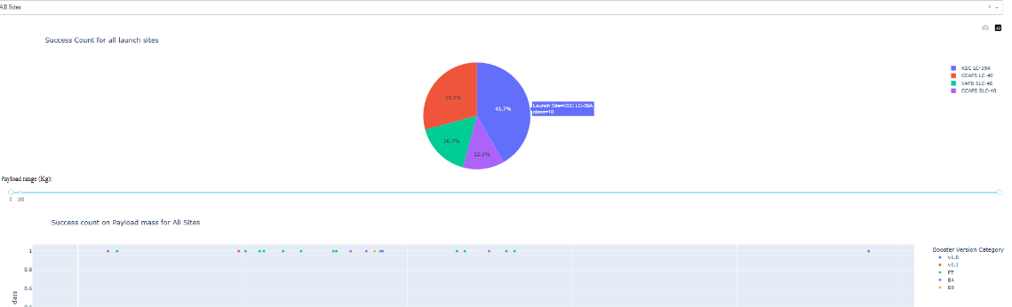
SpaceX Launch Records Dashboard
Interactive Dashboard - Key Insights
- Interactive Exploration: Dashboard allows dynamic filtering by Launch Site and Payload Mass.
- Site Success: Pie chart quickly shows success vs. failure rates for selected sites. Compare sites using the dropdown.
- Payload & Booster Impact: Scatter plot reveals how Payload Mass and Booster Version relate to landing success, filtered by site and payload range.
- Visual Analysis: Explore data patterns and relationships interactively through charts and controls.

Slide 50
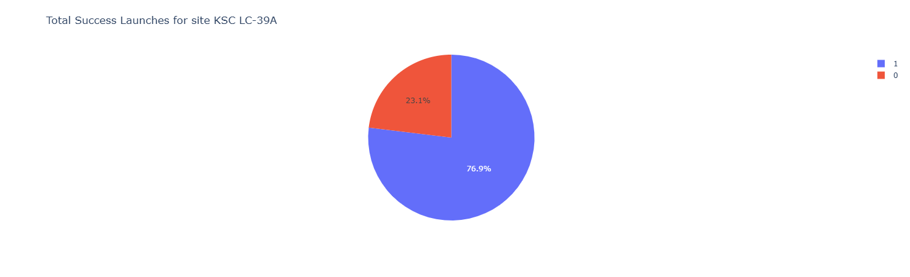
KSC LC-39A (The most successful launches)
This pie chart visualizes the launch success versus failure ratio for the site with the highest success rate.
It clearly shows the proportion of successful landings at this specific location.
Key Finding: This site demonstrates the best performance in achieving successful first stage landings compared to other launch sites.

Slide 51
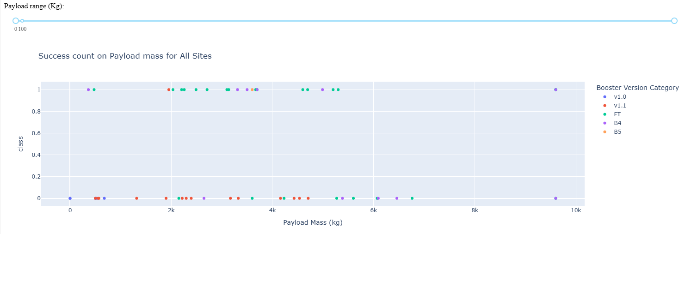
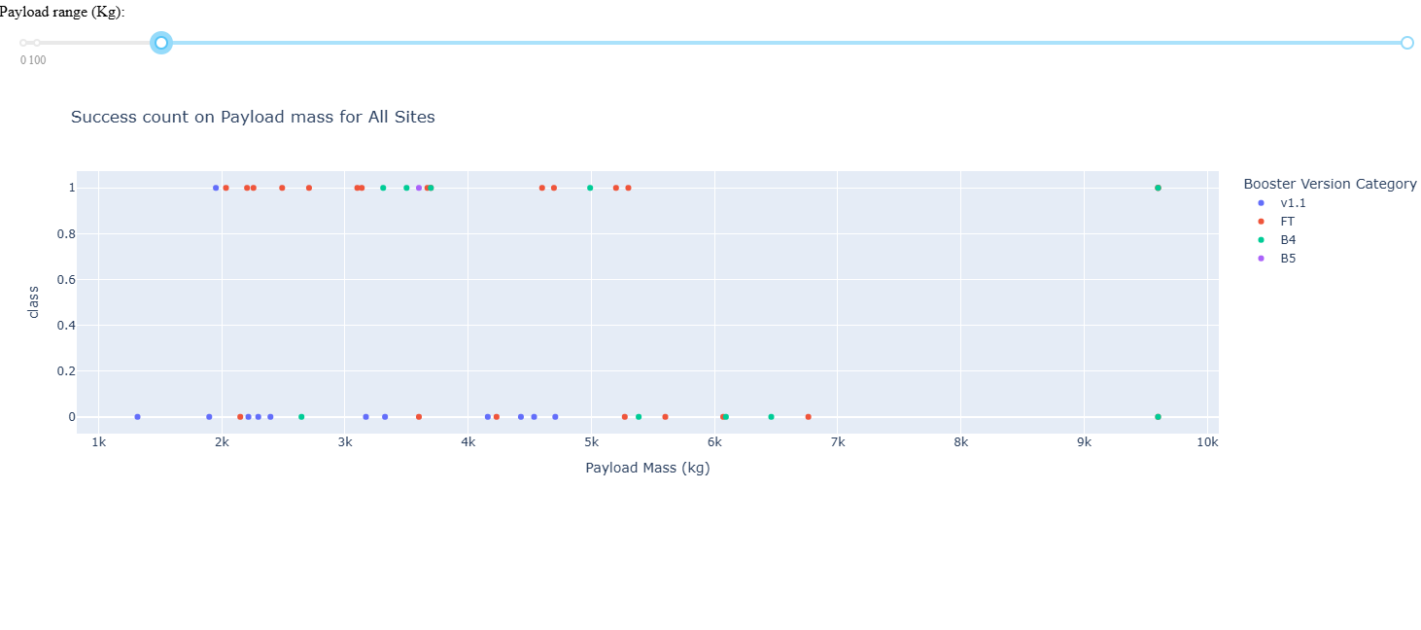
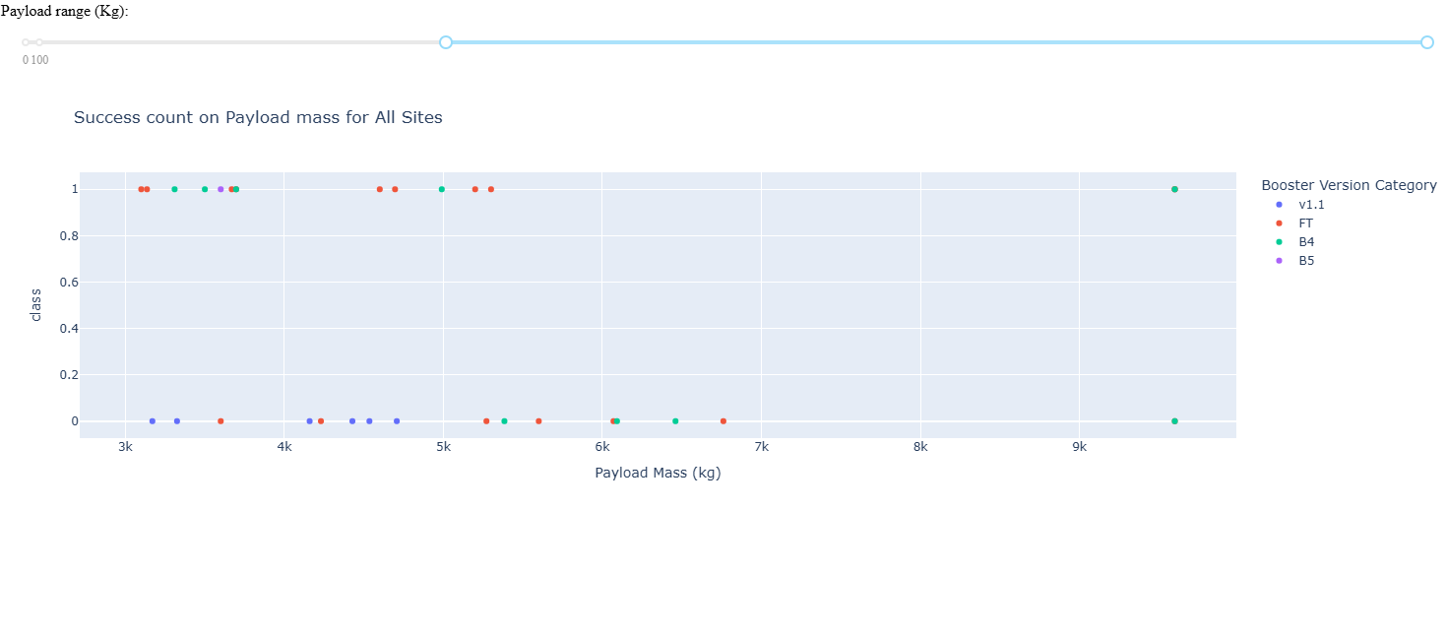
Payload vs. Launch Outcome scatter plot
This scatter plot visualizes the relationship between Payload Mass, Booster Version, and Launch Outcome (Success/Failure) across all launch sites.
By adjusting the payload slider, you can observe points (launches) within specific mass ranges.
Key Findings:
You can visually identify payload mass ranges where successful landings (typically points clustered at class=1) appear more or less frequent.
The color-coding by Booster Version Category helps see if certain booster types are associated with higher success within particular payload or overall ranges.

Slide 52

Section 5

Slide 53
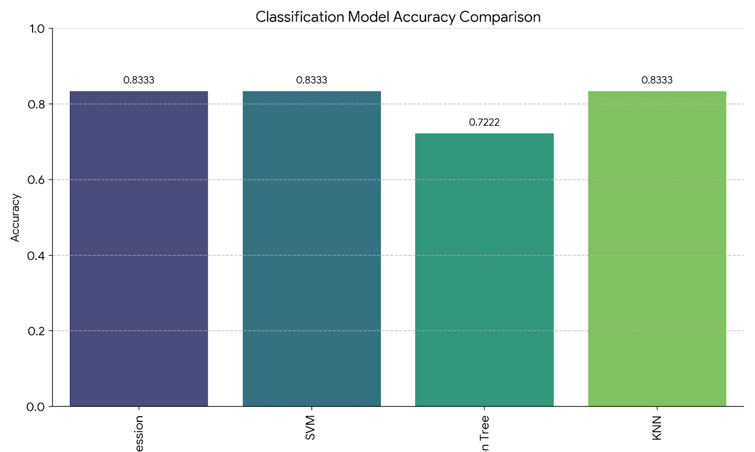
Classification Accuracy
Model with the Highest Accuracy:
Based on the test accuracy scores, the models with the highest classification accuracy (approximately 0.8333) are:
Logistic Regression
Support Vector Machine (SVM)
K-Nearest Neighbors (KNN)
These three models performed equally well on the test dataset in terms of overall accuracy.

Slide 54
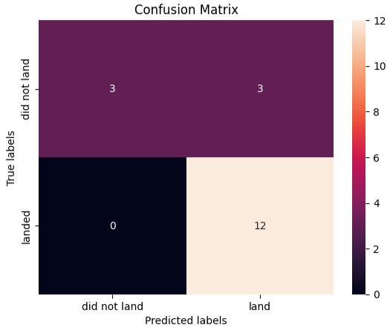
Confusion Matrix of Best Model
This matrix summarizes the performance of one of the best classification models on the test dataset.
It shows how many predictions were correct and incorrect for each class (successful vs. failed landing).
Key Metrics from the Matrix (based on LR/SVM/KNN output):
True Positives (TP): 12 - Correctly predicted successful landings.
True Negatives (TN): 3 - Correctly predicted failed landings.
False Positives (FP): 3 - Incorrectly predicted successful landings (when they actually failed).
False Negatives (FN): 0 - Incorrectly predicted failed landings (when they actually succeeded).
Interpretation: The matrix(Logistic Regression Model) indicates the model was perfect at identifying actual successful landings in this test set (0 False Negatives). However, its main area for potential improvement lies in incorrectly predicting a success when the landing failed (3 False Positives).

Slide 55

Conclusions – Key Findings & Prediction
Insights from Data Analysis (EDA & Visualizations):
Analysis revealed that launch success probability has generally increased over time (Flight Number).
Factors such as Payload Mass, Launch Site, and Orbit Type were found to significantly influence landing outcomes.
Interactive visualizations and SQL queries provided detailed views of success rates by site, payload trends, mission counts, and the geographical context of launch operations.
Project Objective:
The primary goal was to predict the success of SpaceX Falcon 9 first stage landings based on historical mission data.
Predictive Modeling Results:
Several classification models (Logistic Regression, SVM, Decision Tree, KNN) were built and evaluated.
The best-performing models achieved a test accuracy of approximately 0.833.
While accurate overall, the models showed some tendency to incorrectly predict a successful landing when it failed (False Positives) in the test set.

Slide 56
Conclusions – Implications & Future Work
Implications of Findings & Important Factors:
Insights from EDA indicate that operational experience (Flight Number), the mission's payload requirements, and the target orbit are key drivers of landing success.
While model feature importance wasn't explicitly ranked in the notebook code provided, the strong correlations found in EDA suggest that these factors (Flight Number, Payload Mass, Orbit Type, Launch Site) were crucial features informing the models' predictions.
Future Work & Informing Planning/Design:
The predictive model can serve as a tool to forecast the probability of a successful landing for future missions based on planned parameters like payload and orbit.
Insights into the impact of payload, orbit, and launch site can directly inform future mission planning and potentially influence rocket design decisions aimed at improving recovery success rates under specific conditions.
Further work could involve exploring more complex models, incorporating additional features, or focusing on reducing specific types of errors (like False Positives) that were observed.

Slide 57
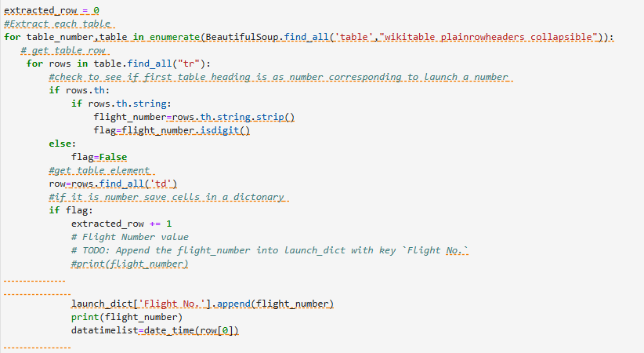
Appendix
Data Collection (HTML Parsing)
This code snippet illustrates the HTML parsing phase of web scraping. It utilizes a library like BeautifulSoup to navigate and extract specific information (such as dates, payload details, and outcomes) from the raw HTML content fetched from a web page. This is a critical step in converting unstructured web data into a structured format suitable for analysis.

Slide 58
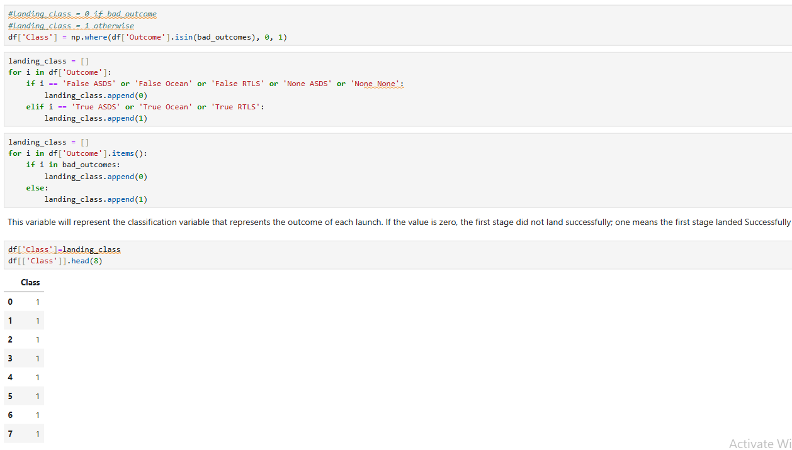
Appendix
Data Wrangling (Create Outcome Label)
This code snippet performs a key data wrangling step by creating a binary label (class) for the landing outcome. It processes the raw Outcome column, categorizing each entry as 1 for a successful landing and 0 for a failed landing or no attempt. This step is crucial for preparing the target variable needed for the classification models in the machine learning phase.

Slide 59
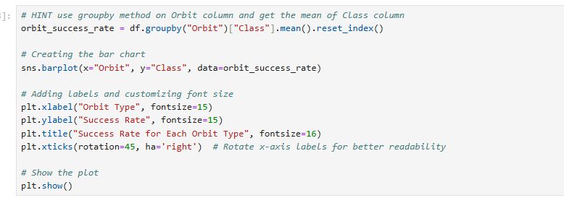
Appendix
EDA Visualization (Bar Chart)
This code snippet generates a bar chart as part of the Exploratory Data Analysis. It visualizes the relationship between a categorical variable (e.g., Launch Site, Orbit Type) and a quantitative measure (e.g., success rate, count of launches). This visualization helps in comparing performance or frequency across different categories at a glance.

Slide 60

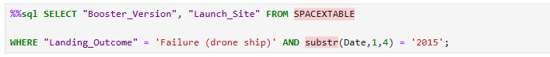
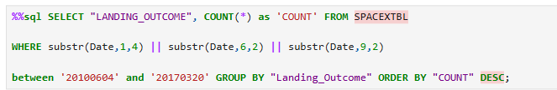
Appendix
SQL Query (Task 8)
This query identifies and lists the Booster Versions that have carried the maximum payload mass recorded in the dataset.
SQL Query (Task 9)
This query filters the data to find failed drone ship landing outcomes specifically within the year 2015, listing the relevant Booster Versions and Launch Sites involved in those attempts.
SQL Query (Task 10)
This query calculates the count of each different landing outcome within a specific date range (between 2010-06-04 and 2017-03-20) and presents the results ranked in descending order of their frequency.

Slide 61
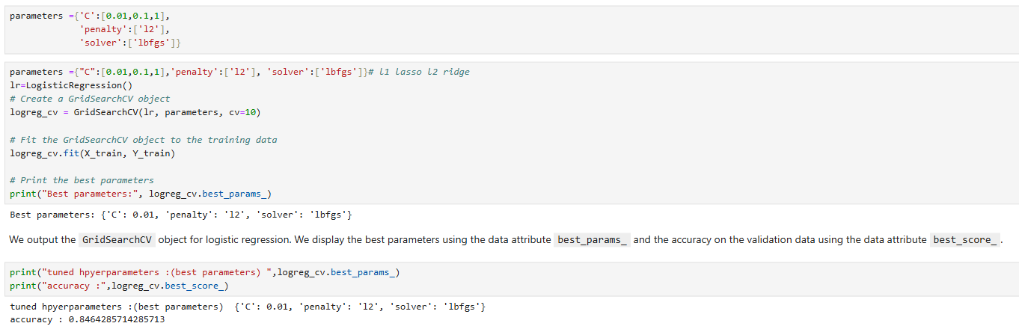
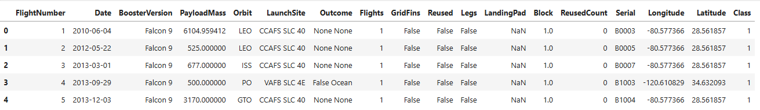
Appendix
Data Wrangling Output (Sample Data)
This screenshot shows the output of df.head(5), displaying the first 5 rows and columns of the dataframe after completing the data wrangling steps. It provides a quick look at the structure and format of the processed data that was used for subsequent analysis and machine learning.
ML Model Evaluation Output
This screenshot displays the results of evaluating a specific machine learning model's performance on the test dataset. It includes output from the code cells (73-75, Task 4) used to calculate key metrics such as accuracy and potentially other evaluation scores for the model's predictive capability.

Slide 62

Appendix
Based on the notebooks for this project, the dataset used was created and compiled through two initial data collection methods:
Data collected from the SpaceX API.
Data collected by web scraping a Wikipedia page about Falcon 9 launch outcomes.
These two sets of data were then combined and processed during the Data Wrangling phase. The resulting cleaned and structured dataset (likely saved as a CSV file, such as spacex_launch_dash.csv based on the Dash app) is the primary dataset that was used for all subsequent steps, including:
Exploratory Data Analysis (EDA)
Building the Folium Interactive Map
Creating the Plotly Dash Dashboard
Developing the Machine Learning Prediction Models

Slide 63
Appendix (Github URLs)
Project Code Repositories & Notebooks:
Lab 1 API Collecting the Data: https://github.com/jheric212/CS-Repo/blob/main/Lab%201%20APICollecting%20the%20Data%20.ipynb
Lab 1.2 Web Scraping: https://github.com/jheric212/CS-Repo/blob/main/Lab%201.2%20Web%20Scraping.ipynb
Lab 2 Data Wrangling: https://github.com/jheric212/CS-Repo/blob/main/Lab%202%20Data%20Wrangling.ipynb
EDA with Visualization_Exploring and Preparing Data: https://github.com/jheric212/CS-Repo/blob/main/EDA%20with%20Visualization_Exploring%20and%20Preparing%20Data.ipynb
EDA with SQL_SQL Notebook for Peer Assignment: https://github.com/jheric212/CS-Repo/blob/main/EDA%20with%20SQL_SQL%20Notebook%20for%20Peer%20Assignment.ipynb
Interactive Visual Analytics with Folium: https://github.com/jheric212/CS-Repo/blob/main/Interactive%20Visual%20Analytics%20with%20Folium.ipynb
spacex_dash_app.py: https://github.com/jheric212/CS-Repo/blob/main/spacex_dash_app.py
Machine Learning Prediction Lab: https://github.com/jheric212/CS-Repo/blob/main/Machine%20Learning%20Prediction%20lab.ipynb

Slide 64


